Slide 1

IDENTIFY INDIVIDUALS USING FACIAL RECOGNITION MECHANISM
NAME : SHONA S
ROLL.NO : 2021UAD1013
DEPARTMENT : ARTIFICIAL INTELLIGENCE AND DATA SCIENCE

Slide 2
ABSTRACT
Facial recognition is a way of recognizing a human face through technology. It utilizes a biometric system to plan facial elements from photos or videos. It compares an information with a database or dataset of known faces to track down a match and it’s because the facial recognition has many applications. Face detection is defined as the process of extracting faces from scenes. So, the system positively identifies a certain image region as a face. This procedure has many applications like face tracking, pose estimation or compression. The next step -feature extraction- involves obtaining relevant facial features from the data. These features could be certain face regions, variations, angles or measures, which can be human relevant (e.g., eyes spacing) or not. This phase has other applications like facial feature tracking or emotion recognition. Finally, the system does recognize the face. In an identification task, the system would report an identity from a database. This phase involves a comparison method, a classification algorithm and an accuracy measure. This phase uses methods common to many other areas which also do some classification process -sound engineering, data mining. Nowadays some applications of Face Recognition don’t require face detection. In some cases, face images stored in the data bases are already normalized. There is a standard image input format, so there is no need for a detection step. An example of this could be a criminal database. There, the law enforcement agency stores face of people with a criminal report.

Slide 3
PROBLEM STATEMENT
The image of an individual is captured and the facial is extracted to find the image stored in the database , then the image is compared with others .After the comparison, the image must be matched to the individual and the face is recognized.

Slide 4
EXISTING SOLUTION TO THE PROBLEM ADDRESSED
Step 1: Hardware to capture the images. These images can also be fed into the software from independent devices.
Step 2 : Intelligence to compare the captured faces with existing data.
Step 3 : Database, an existing collection of identities. These can be anything from employee databases to images scrubbed from social media.

Slide 5
PROPOSED SOLUTION TO THE PROBLEM ADDRESSED
A complete face recognition system includes face detection, face preprocessing and face recognition processes. Therefore, it is necessary to extract the face region from the face detection process and separate the face from the background pattern, which provides the basis for the subsequent extraction of the face difference features. The recent rise of the face based on the depth of learning detection methods, compared to the traditional method not only shorten the time, and the accuracy is effectively improved. Face recognition of the separated faces is a process of feature extraction and contrast identification of the normalized face images in order to obtain the identity of human faces in the images. The purpose of the facial feature point positioning is to further determine facial feature points (eyes, mouth center points, eyes, mouth contour points, organ contour points, etc.) on the basis of the face area detected by the face detection / tracking, s position. The methods for face positioning and face alignment are the vital one. The basic idea of locating the face feature points is to combine the texture features of the face locals and the position constraints of the organ feature points.

Slide 6
Facial feature extraction is a face image into a string of fixed-length numerical process. This string of numbers is called the "Face Feature" and has the ability to characterize this face. Human face to mention 12 the characteristics of the process of input is "a face map" and "facial features key points coordinates", the output is the corresponding face of a numerical string (feature). Face to face feature algorithm will be based on facial features of the key point coordinates of the human face predetermined mode, and then calculate the features. In recent years, the deep learning method basically ruled the face lift feature algorithm, In the articles mentioned above, they showed the progress of research in this area. These algorithms are fixed time length algorithm. Earlier face feature models are larger, slow, only used in the background service. However, some recent studies can optimize the model size and operation speed to be available to the mobile terminal under the premise of the basic guarantee algorithm effect.

Slide 7
PROJECT WORK PLAN
To detect a face, a human operator would identify the locations of the subject's eyes in an image and using the proportions of the average face, the system would segment an area from the image A template matching based technique was implemented for face recognition. This was because of its increased recognition accuracy when compared to geometrical features based techniques and the fact that an automated geometrical features based technique would have required complex feature detection pre-processing. Of the many possible template matching techniques, Principal Component Analysis was chosen because it has proved to be a highly robust in pattern recognition tasks and because it is relatively simple to implement.

Slide 8
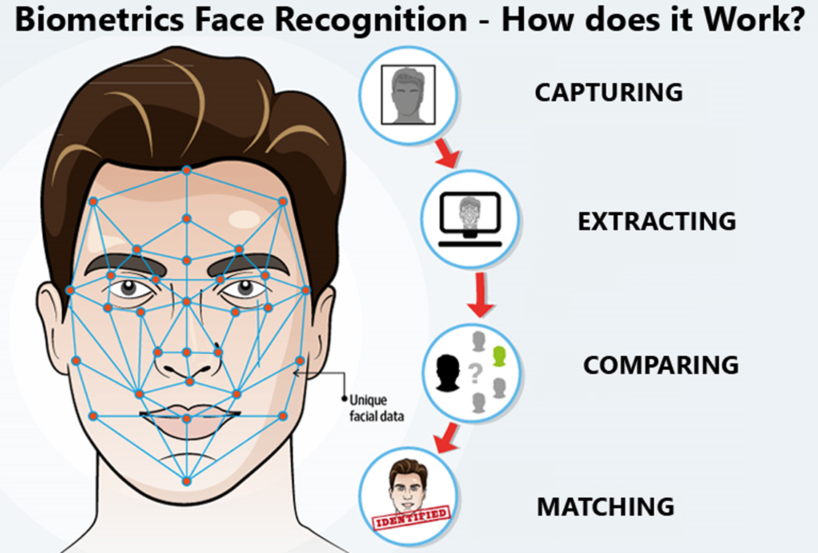
BLOCK DIAGRAM

Slide 9
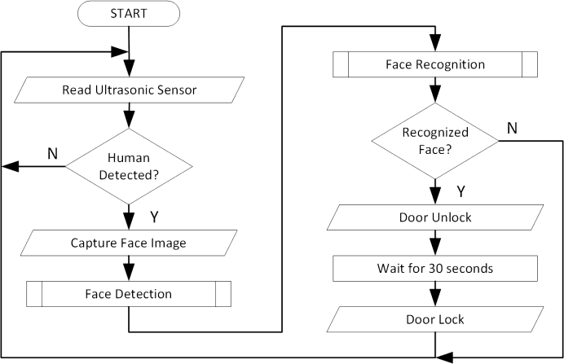
FLOWCHART

Slide 10
EFFECTIVE UTILIZATION
Prevent retail crime
Unlock mobile phone
Find missing persons
Help the blind
Protect Law enforcement
AI Forensic Investigations
Track attendance in Schools,Offices

Slide 11
TECHNOLOGY STACK & USE CASES
The image of an individual is captured and the facial is extracted to find the image stored in the database , then the image is compared with others .After the comparison, the image must be matched to the individual and the face is recognized.

Slide 12
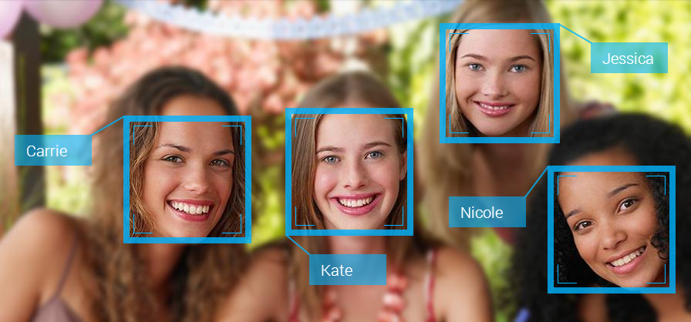
PROTOTYPE AND SAMPLE OUTPUT
Facial recognition uses computer-generated filters to transform face images into numerical expressions that can be compared to determine their similarity. These filters are usually generated by using deep “learning,” which uses artificial neural networks to process data.

Slide 13
ANALYSIS OF RESULT AND DISCUSSION
Integrating such new technology into an application was more difficult than initially considered. Most problems encountered were hard to find solutions. However, through lots of research, some solutions were found . Starting with a base foundation of machine learning concepts and mathematical understanding was extremely beneficial in adapting to future concepts and problems. The concepts were well understood, but the coding implementation proved challenging given the circumstances, and a proper database of registered users was not able to be created.

Slide 14
COST BENEFIT ANALYSIS
S.NO | MATERIALS
1 | 4 GB RAM (MINIMUM)
2 | 80 GB HDD
3 | Dual core processor
4 | CDROM (Installation only)
5 | VGA Resolution monitor
6 | Microsoft Windows 98/2000/NT with service pack 6 / XP with service pack 2/ Windows 7 with service pack 2
7 | SQL server 2008 R2

Slide 15
WORKING VIDEO
1)https://youtu.be/YX8BzK_LU0E
2)https://youtu.be/1aHub80AHFk

Slide 16
REFERENCES
W. Hwang (2010), "Face Recognition System Using Multiple Face Model of Hybrid Fourier Feature under Uncontrolled Illumination Variation" .
https://www.kaspersky.com/resource-center/definitions/what-is-facial-recognition

